Slide 1
Software Engineering
Dr. Fatma ElSayed
Dr. Ahmed Yousry
Computer Science Department

Slide 2
Course Information
Contents
Introduction to Software Engineering
Software Processes
Requirements Engineering
System Modelling Part 1
System Modelling Part 2
System Modelling Part 3
System Architecture
Software Testing Strategies
Software Testing Techniques
Technical Metrics for Software

Slide 3
Course Information
Contents
Introduction to Software Engineering
Software Processes
Requirements Engineering
System Modelling Part 1
System Modelling Part 2
System Modelling Part 3
System Architecture
Software Testing Strategies
Software Testing Techniques
Technical Metrics for Software

Slide 4
Chapter 5: System Modelling

Slide 5
Sequence Diagram

Slide 6
Interaction Models
All systems involve interaction of some kind. This can be:
User interaction, which involves user inputs and outputs (helps to identify user requirements).
Interaction between the system being developed and other systems (highlights the communication problems that may arise).
Interaction between the components of the system (helps us understand if a proposed system structure is likely to deliver the required system performance and dependability).
Two related approaches to interaction modelling:
Use case modelling, which is mostly used to model interactions between a system and external actors.
Sequence diagrams, which are used to model interactions between system components, although external agents may also be included.

Slide 7
Sequence Diagram
A sequence diagram shows the sequence of interactions that take place during a particular use case to fulfill a specific task.
Each diagram represent one of the flows through a use case.
Each Use Case requires one or more sequence diagrams to describe its behavior.
Sequence diagrams are interaction diagrams ordered by time.
Shows, step-by-step, flows through a use case:
What objects are needed for the flow.
What messages the objects send to each other.
What actor initiates the flow.
What order the messages are sent.

Slide 8
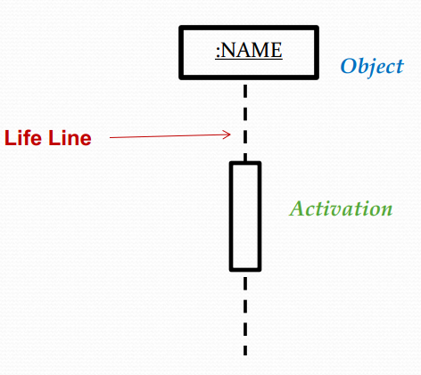
Object Lifeline
A lifeline is shown as a vertical, usually dashed line that represents the lifetime of the object associated with it.
At the top end of the line is the head of the lifeline, a rectangle which contains an expression in the form roleName:Class.
This expression indicates the role name and the class of the object associated with the lifeline
Active
Inactive

Slide 9
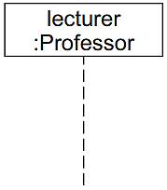
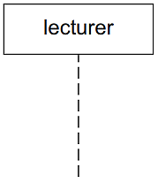
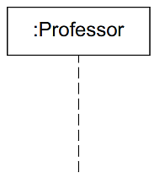
Types of Object Lifeline
If the class is omitted, the colon can also be omitted; if only the class is specified, it must be preceded by a colon.
Role / Class
Role
Class

Slide 10
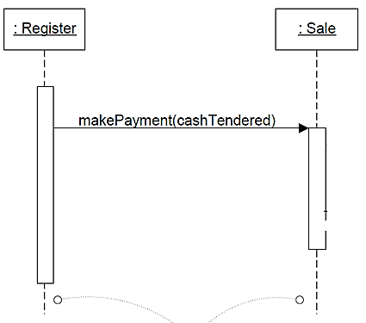
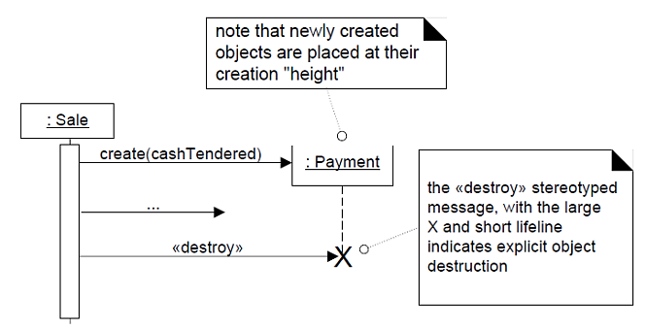
Object Lifeline
The sequence diagram is a two-dimensional diagram.
The top-to-bottom dimension shows the passage of time. [vertical]
The left-to-right dimension is the layout of the objects. [horizontal]

Slide 11
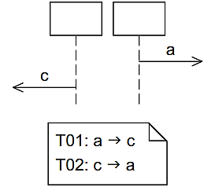
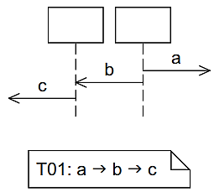
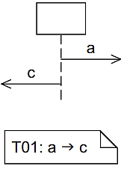
Exchanging Messages
On different lifelines
which exchange
messages:
On one lifeline
..Happens before
On different lifelines

Slide 12
Exchanging Messages
A message is shown as an arrow from the sender to the receiver.
The type of the arrow expresses the type of communication involved, and there are two types of messages:
A synchronous message is represented by an arrow with a continuous line and a filled triangular arrowhead.
The sender waits until it has received a response message before continuing.
The response message is represented by a dashed line with an open arrowhead.
Call message
Return from message

Slide 13
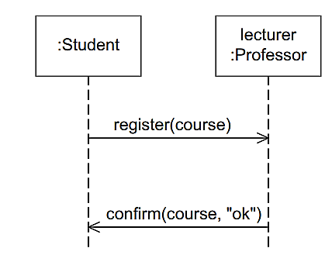
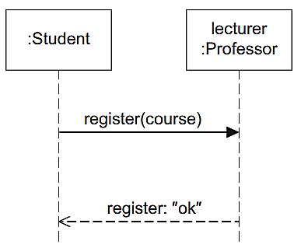
Exchanging Messages
An asynchronous message is represented by an arrow with a continuous line and an open arrowhead.
The sender continues after having sent the message.
Asynchronous
Synchronous
Register for a course
Notes:
In case (a), registration is asynchronous via e-mail, and the student doesn’t wait for confirmation. In case (b), registration is synchronous, as the student registers directly with the professor and waits for a response. Register(course) is a function implemented in class Professor.

Slide 14
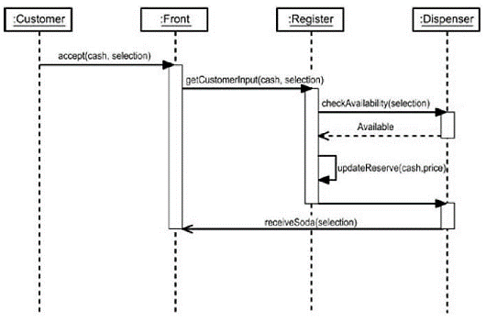
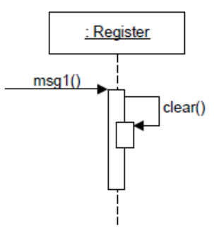
Message to Self
The Soda Machine: buying soda

Slide 15
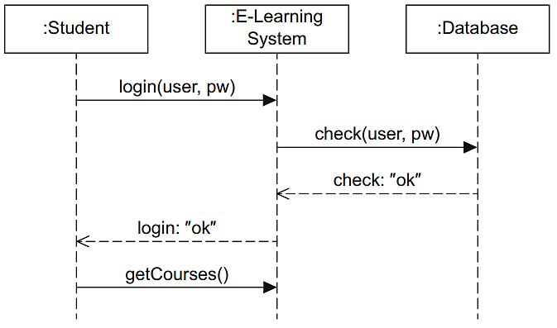
Sequence Diagram: Example
Login Process

Slide 16
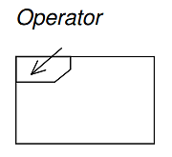
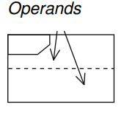
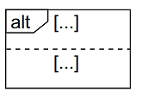
Alternatives and Iterations
In a sequence diagram, you can use combined fragments (operators) to describe a number of possible execution paths.
You can use an alt fragment to represent alternative sequences, each operand represents an alternative path in the execution.
Each operand has a guard.

Slide 17
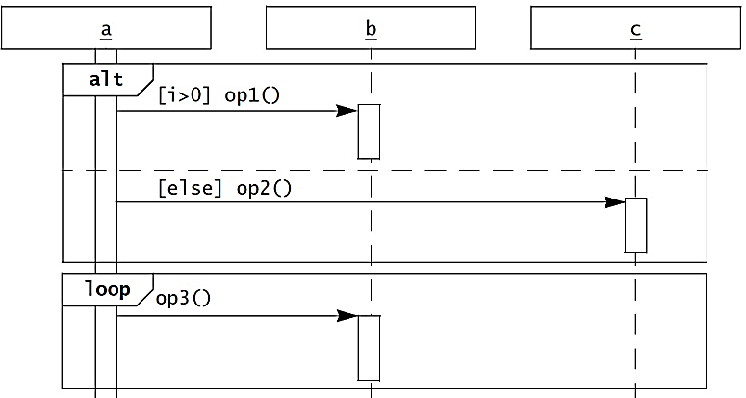
Alternatives and Iterations: Example
Loop

Slide 18
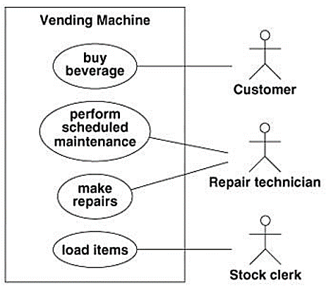
System Sequence Diagram (SSD)
For a use case scenario, an SSD shows:
The System (as a black box).
The external actors that interact with System.
The System events that the actors generate.
Notes:
Interaction between the actors and system from outside يعنى من بره)), not from inside with details.

Slide 19
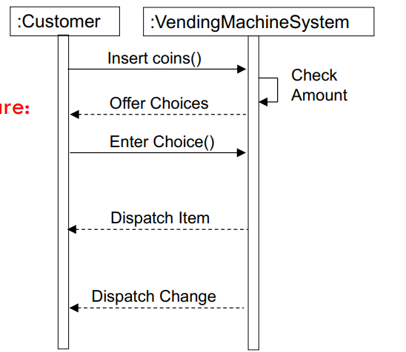
System Sequence Diagram (SSD)
The System events are:
Insert coins()
Enter choices()

Slide 20
Class Diagram

Slide 21
Structural Models: Class Diagram
Class diagrams are used when developing an object-oriented system model to show the classes in a system and the associations between these classes.
A class model captures the static structure of the system by characterizing:
The classes and objects in the system,
The attributes and operations for each class of objects, and
The relationships among the objects.
Class models are the most widely used UML diagram.
In OO systems we build the system around objects, not functionality.
Notes:
These elements and the relationships between them do not change over time.

Slide 22
Objects
Objects represent something in the real world, such as a patient, a course, a doctor, etc.
Objects often appear as proper nouns in the problem description or discussion with the customer.
The choice of objects depends on the analyst’s judgment and the problem at hand. There can be more than one correct representation.
A class is the description of a set of objects (having similar attributes, operations, relationships, and behavior). while Objects are instances of classes.

Slide 23
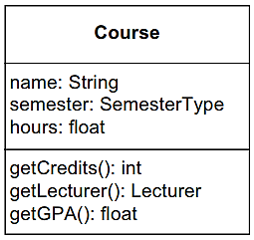
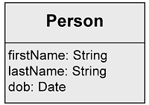
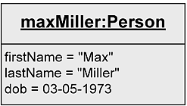
Objects
Class
Class name
Attributes
Operations
An object of that class

Slide 24
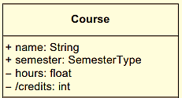
Class Attributes
An attribute allows you to store information that is known for all instances.
Attribute declaration may include visibility, type and initial value
Who is permitted to access the attribute
+ ... public: everybody
- ... private: only the object itself
# ... protected: class itself and subclasses
visibility
Notes:
/credits the / symbol refer that credits is computed not stored directly in DB, like age is derived from date of birth

Slide 25
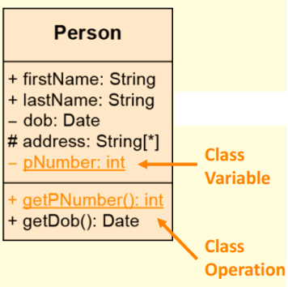
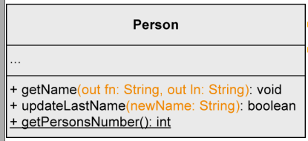
Class Attributes & Operations
Operations enable objects to communicate with one another and to act and react.
An operation may include visibility, parameters, and return type:

Slide 26
Relationships
Association
Generalization
Relationships
Aggregation
Composition

Slide 27
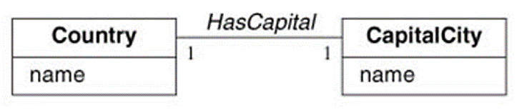
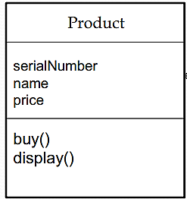
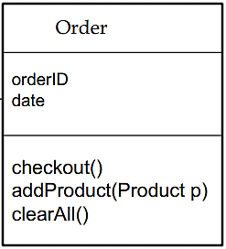
Associations
An association is a relationship between classes and represented by a line with a name.
An optional "reading direction arrow" indicates the direction to read the association name.
*
*
Multiplicity

Slide 28


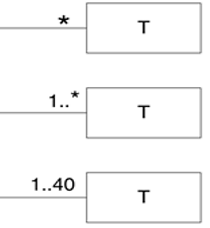
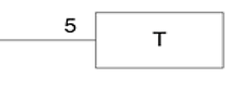
Multiplicity
Multiplicity: The Number of objects that may be associated with exactly one object of the opposite side.
Zero or more
One or more
Exactly 5
One to 40

Slide 29


Aggregation
An aggregation is a special form of association that is used to express that instances of one class are parts of an instance of another class.
Represented by a diamond at the association end of the class that stands for the “whole”.
Expresses a weak belonging of the parts to a whole, meaning that parts also exist independently of the whole.
Whole
Part
The multiplicity at the aggregating end may be greater than 1

Slide 30
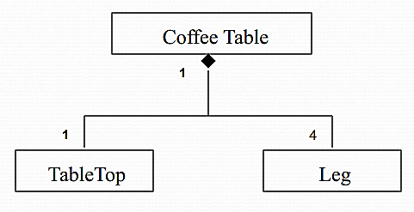

Composition
A strong form of aggregation
The part object may belong to only one whole
The life time of the part is dependent upon the whole.
The composite must manage the creation and destruction of its parts.
The multiplicity at the composition end must be zero or 1

Slide 31
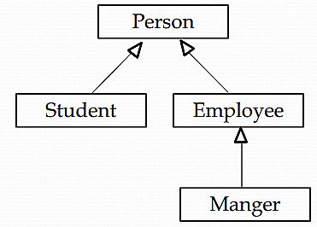
Generalization
The generalization relationship is also referred to as inheritance.
A class might have no parents, which is a base class or root class.
A class might have no children, in which case it's a leaf class.
If a class has exactly one parent, it has a single inheritance.
If a class has more than one parent, it has multiple inheritance.
Inheritance is called “is-a” relationship.
Notes:
Different classes often have common characteristics.

Slide 32
Thank You

